Slide 1
From Principles to Practice: Responsible Innovation
Pre-Conference Faculty Workshop

Slide 2
Who We Are
Global Academic Programs

Slide 3

Global Academic Programs
Our Mission: Empowering Analytics for Academics
We support the next generation by providing free software and resources for academia.
Our “customers” are students, educators, independent learners, and academic researchers.
www.sas.com/academics

Slide 4
Resources for Teaching and Learning
SOFTWARE
TRAINING
EDUCATIONAL
RESOURCES
SAS® Viya® for Learners
SAS® OnDemand for Academics
SAS® Viya® Workbench for Learners
e-Learning
How-to videos
Onsite & virtual training
Teaching materials
Curriculum consulting
Academic specializations
SAS Educator Portal
SAS Skill Builder for Students

Slide 5
Agenda
Responsible and Ethical Data Use
SAS Viya for Learners
Ethical Data Analysis

Slide 6
Responsible and Ethical Data Use

Slide 7
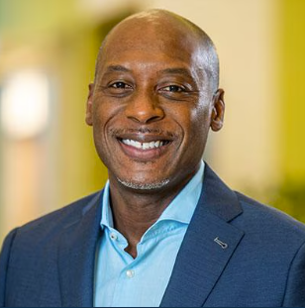
Our vision is a world where data empowers people to thrive. We pursue that vision through trustworthy and responsible innovation.
Reggie Townsend, Vice President of the Data Ethics Practice, SAS
Notes:
SAS is committed to using data and analytics in a meaning way.
We have a Data Ethics Practice to make sure we as a company are using data ethically, but also to spread the word about ethical use of data.
Reggie is a big deal!! He is a member of the National AI Advisory Committee that advises the US President and the National AI Initiatives Office on a range of issues that relate to the development and the use of AI.

Slide 8
Responsible Innovation in Academia
RESPONSIBLE
CAREER READY
THOUGHT-LEADERS
data scientists
citizens
future of industry
implications of solutions
critical thinking
ignite curiosity
Notes:
### **Responsible (Data Scientists and Citizens)**
- Emphasizes responsible data use in an increasingly digital world.
- Encourages awareness of the societal impact of technology, including its effects on individuals and marginalized groups.
- Highlights the growing industry focus on ethical AI and the need for students to be well-versed in this space.
- Stresses ethical decision-making, ensuring students contribute to trustworthy causes and align with companies that share their values.
### **Career-Ready (Future of Industry and Implications of Solutions)**
- Prepares students for careers by providing a broad perspective on data-driven work.
- Ensures students understand how their work impacts specific industries and real-world applications.
- Aims to develop passionate professionals who advance the field with a well-rounded, ethical mindset.
### **Thought-Leaders (Critical Thinking and Igniting Curiosity)**
- Encourages students to think critically about data and technology.
- Promotes ethical questioning: *Not just can you build a solution, but should you?*
- Engages students in ethical dilemmas, such as the classic trolley problem, to foster moral reasoning.
- Inspires curiosity and higher-level thinking to develop future innovators and leaders.

Slide 9
The Responsible Innovation Journey
Digital Ethics: Work that is performed in service to responsible innovation to satisfy values, in accordance with principles, and in support of governance
Data Ethics: Seeks to cure automated decision-support systems from the negative consequences of data quality issues
Ethical AI: A discipline concerned with fairness, bias, and efficacy of decision-support systems
Responsible Innovation: Builds trust in the future through collective stewardship of science, products, and culture
Responsible Innovation
Digital Ethics
Data Ethics
Ethical AI
Notes:
Steven Tiell
KEY TERMS
Responsible innovation is EVERYONE’S job to safeguard progress…
Responsible: having an obligation to do something, or having control over or care for someone, as part of one's job or role.
Innovation: the process of bringing about new ideas, methods, products, services, or solutions that have a significant positive impact and value
*Words that relate to ethics include morality, principles, standards, values, virtues, conscience, and integrity.*
Digital ethics is a set of moral principles that guide how people and organizations use technology
Data ethics covers the ethical and moral obligations of collecting, sharing, and using data, focused on ensuring that data is used fairly, for good
Ethical AI is the use of artificial intelligence (AI) in a way that is responsible, transparent, and respectful of human values

Slide 10
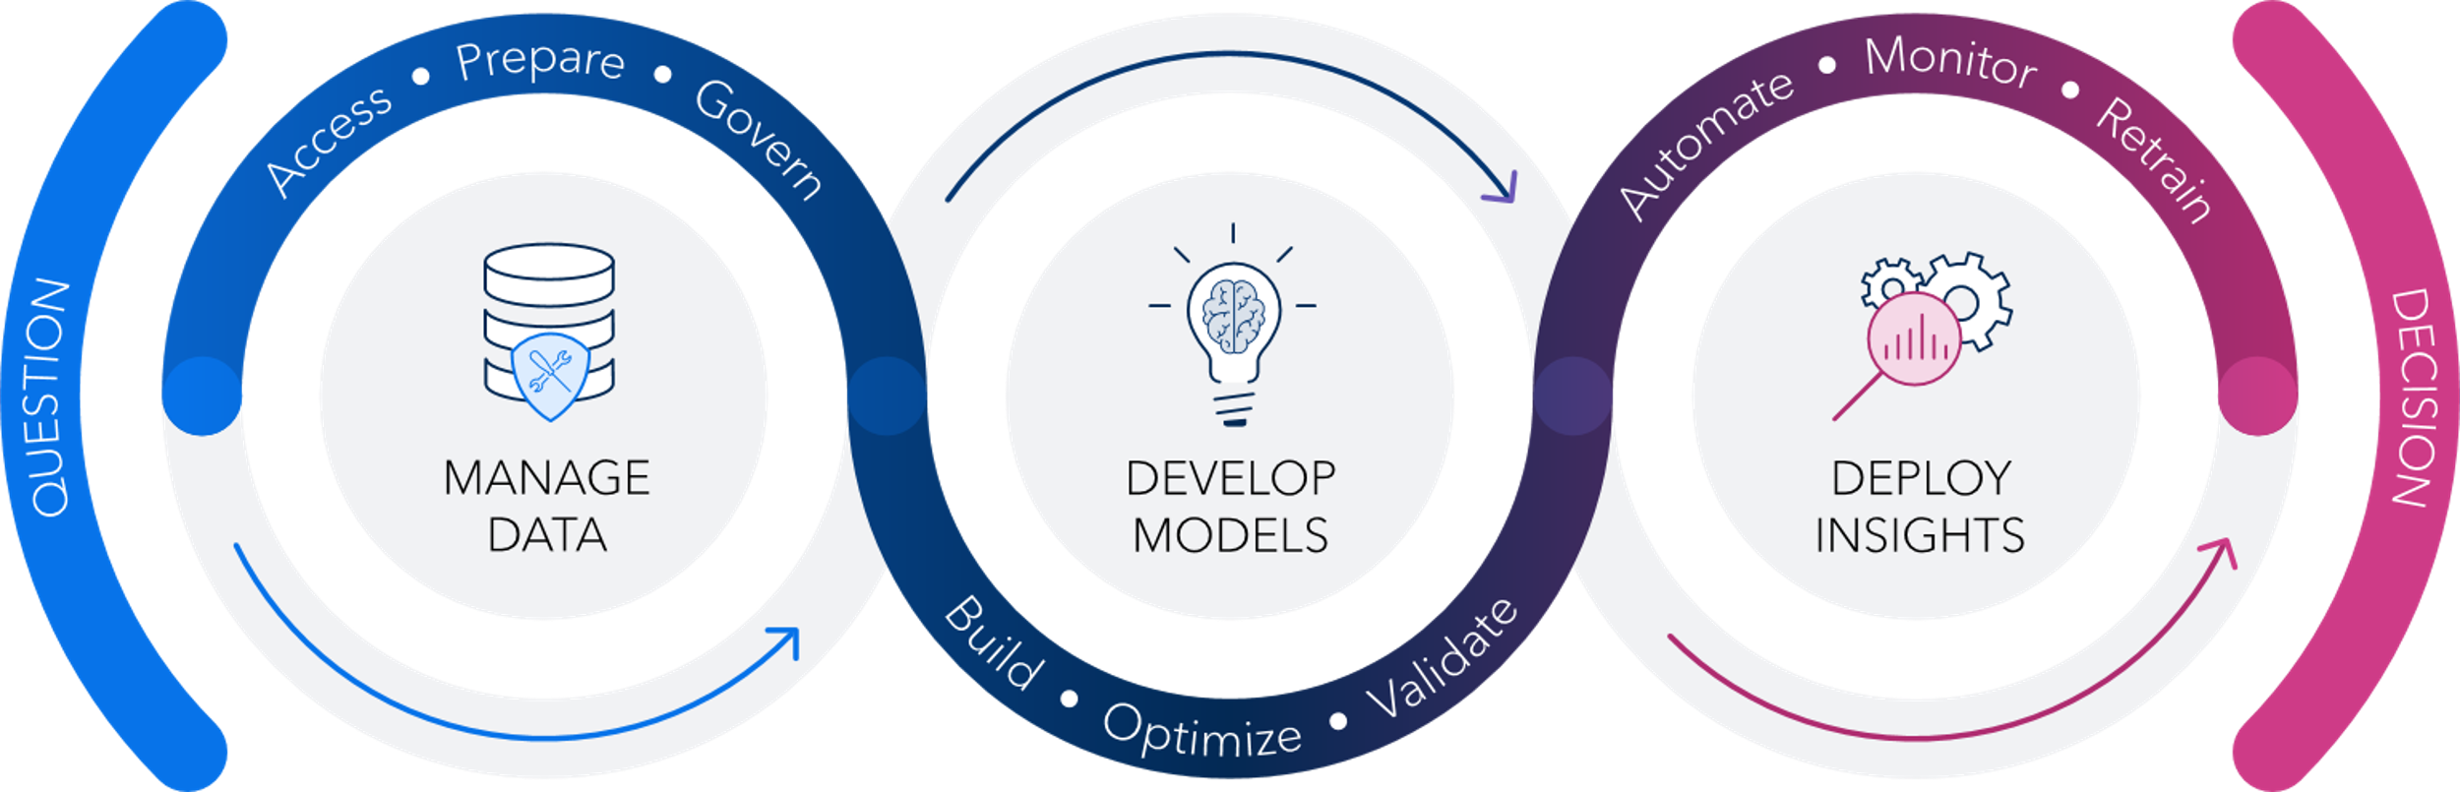
AI and Analytics Life Cycle
Notes:
You work with data and analytics every day and likely don’t give it much more thought than what’s on the “fringe.”
Analytics begins with a question, and it leads to a decision. Between asking the question and making decisions, however, a LOT of things can happen.
The AI and analytics life cycle is a framework for breaking those activities apart between asking and deciding. Each part of the life cycle brings unique challenges. Analysts want to be able to go quickly through the life cycle, but also responsibly so that they can make the best decisions possible.
The AI and analytics life cycle is a continuous process of managing data, developing models, and then getting them deployed into production.

Slide 11
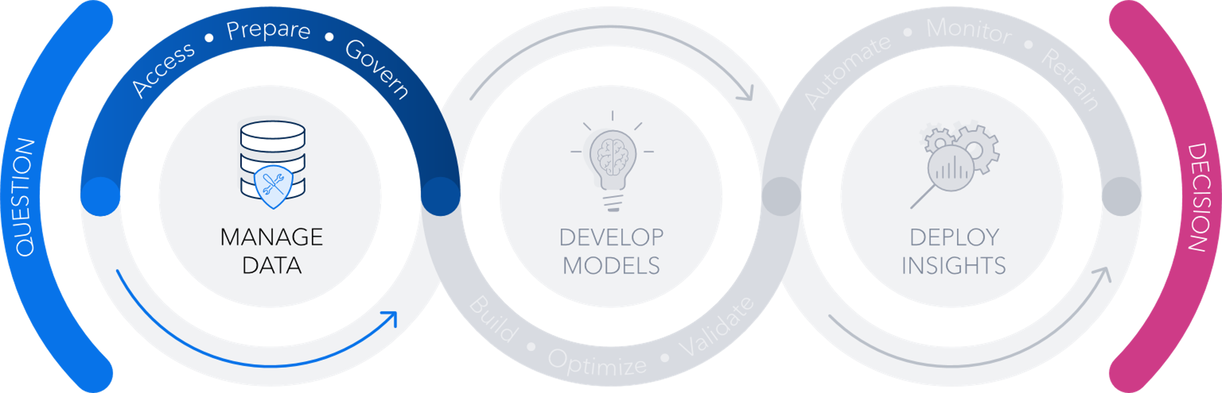
Manage Data
Access
Access data, regardless of size or complexity
Prepare
Transform raw data, including AI powered suggestions
Govern
Build trust in data, understand lineage and gain transparency
Notes:
Managing data can be thought of as the design phase of the AI and Analytics life cycle. At this point, ask yourself some key questions: Where do the data reside? Is there PII (personally identifiable information) in the data? What form of data do we need to explore and train models? Should we build an AI system, and what are the alternatives? Are we aware of data governance best practices?
Borrowing from agile software development practices, DataOps provides an agile approach to data access, quality, preparation, and governance. It enables greater reliability, adaptability, speed, and collaboration in your efforts to operationalize data and analytic workflows.

Slide 12
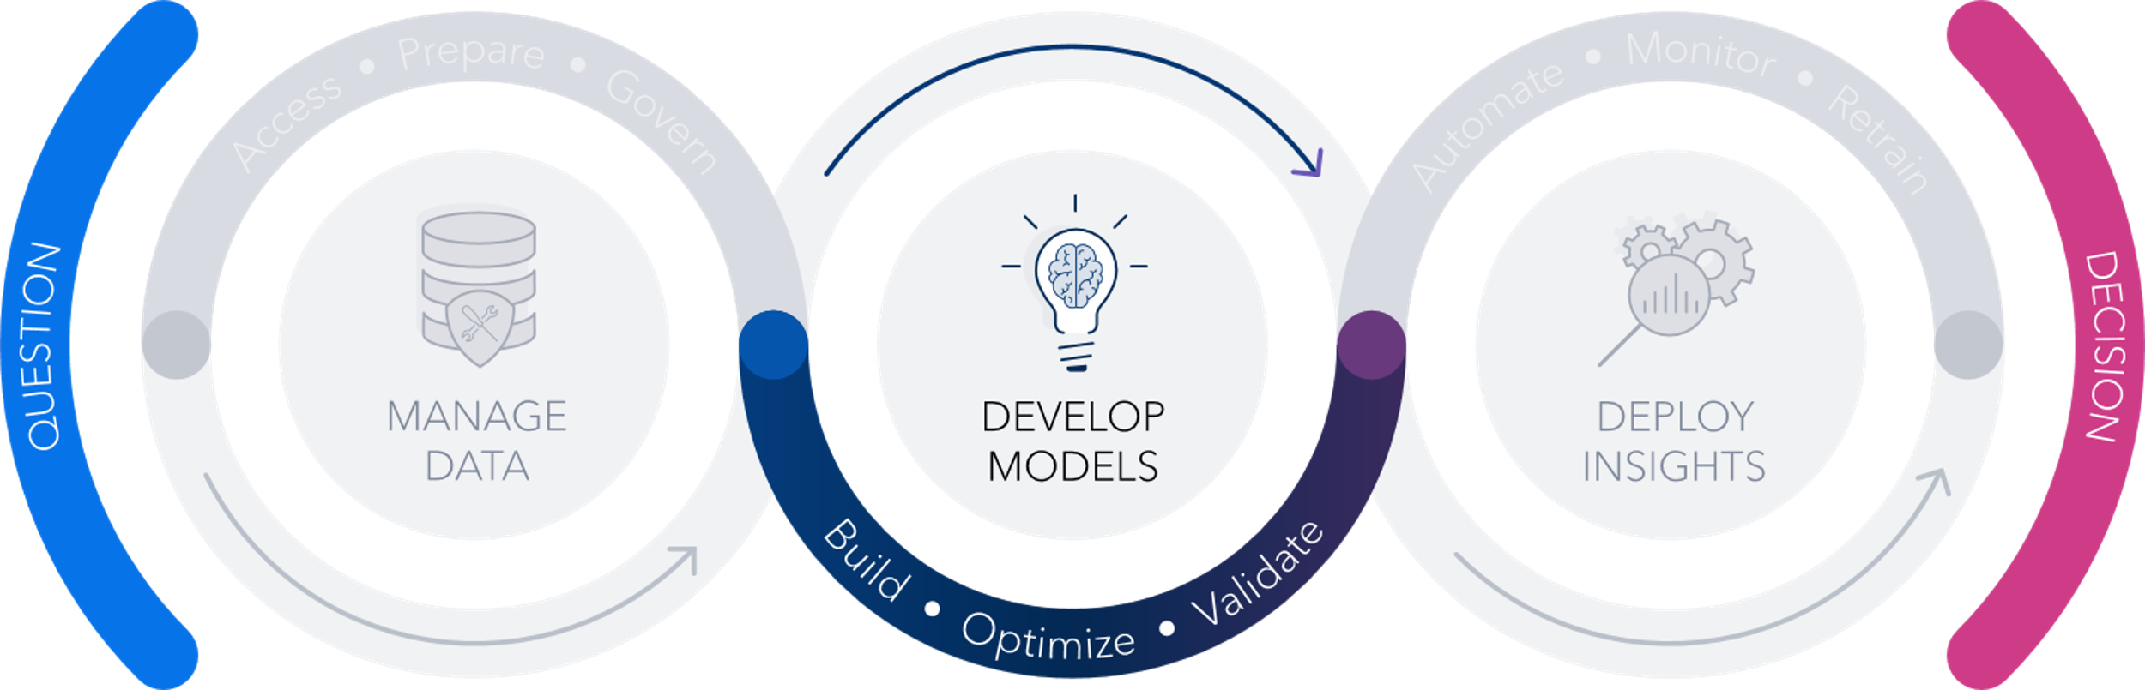
Develop Models
Build
Build models with multiple AI techniques to solve real world problems
Optimize
Embed models into operational systems and monitor them
Validate
Ensure model’s input and output variables align with business' expectations
Notes:
Data scientists use a combination of techniques to understand the data and build predictive models. They use statistics, machine learning, deep learning, natural language processing, computer vision, forecasting, optimization, and other techniques to answer real-world questions. These skills are at the heart of building, optimizing, and validating models.

Slide 13
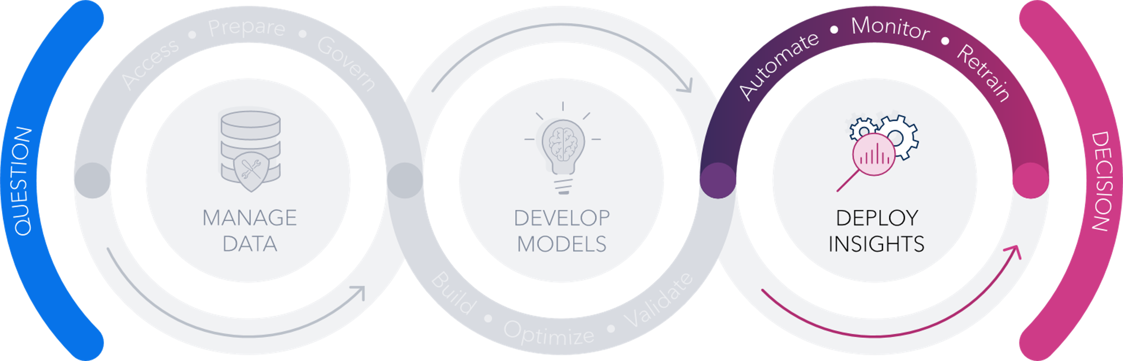
Deploy Insights
Automate
Automate manual tasks for feature engineering and model tuning
Monitor
Monitor model's inputs, output and performance over time, leveraging built-in alerts
Retrain
Revise, retrain or replace models leveraging built-in pipelines to ensure optimal performance
Notes:
After a model has been selected, something must be done to make use of it, by deploying model insights. ModelOps focuses on getting AI models through validation, testing, and deployment phases as quickly as possible, while ensuring quality results. It also focuses on ongoing monitoring, retraining, and governance of models to ensure peak performance and that decisions are transparent.

Slide 14
Notes:
The AI & Analytics life cycle helps you organize the activities you perform in going from a Question to making a Decision.
To the extent that data are driving those decisions, you can also consider how the data are being generated, curated, stored, and consumed.

Slide 15
Responsible Innovation Across the Data Supply Chain
Acquire
Store
Pre-process
Model Build
Model Deploy
Share/Sell
Dispose
Notes:
The data chain of custody, or the data supply chain, is a useful heuristic for organizing the migration of data from acquisition to disposal, and everywhere in between.
Responsible innovation in the data supply chain “seeks to cure automated decision-support systems from the negative consequences of data quality issues with a systemic approach to integrity and provenance throughout the data supply chain.”
-- In simpler terms, responsible innovation in the data supply chain means making sure that automated systems make decisions based on accurate, trustworthy data. If the data is flawed, the system can make bad choices. To prevent this, responsible innovation focuses on keeping data clean, reliable, and properly tracked from start to finish—so businesses and organizations can trust the insights they get.
One value in thinking about the data supply chain alongside the AI and Analytics life cycle is that you have an organizing map for the custodial responsibility of working with any data in any context. Knowing where you are along the data supply chain can help you think about potential challenges, pitfalls, and common biases that can arise in working with data.

Slide 16
Responsible Innovation Across the Data Supply Chain
Manage, Prepare, and Model
Obtain Data
Deploy and Consume
Acquire
Store
Pre-process
Model Build
Model Deploy
Share/Sell
Dispose
Notes:
Let’s look at the phases of the data supply chain.
Starting the data supply chain, a person, process, or system creates and publishes/shares data.
To start working with any data source, you must acquire the data, from sensors, systems, or humans, recording its provenance and consent for use wherever possible.
The data then needs to be stored somewhere, which entails recording data to a trusted location that is both secure and easily accessible for further manipulation.
You’ve obtained data, and now a person, process, or system transforms, moves, or analyzed data. This is when data are managed, prepared, and modeled. Most of the AI & Analytics life cycle runs alongside this part of the data supply chain.
During pre-processing, you combine disparate data sets to create a larger dataset that is greater than the sum of its parts.
During model building, you examine and transform data with the purpose of extracting information and discovering new insights.
Finally, a person, process, or system benefits from manipulated data. This is when data are deployed and consumed.
Model deployment applies the insights gained from data analysis towards making decisions, affecting change, or delivering a product or service.
Sharing and/or selling data entails providing access or data insights to new sets of data manipulators or consumers.
Finally, you dispose of data by removing data from servers to prevent future release or use.

Slide 17
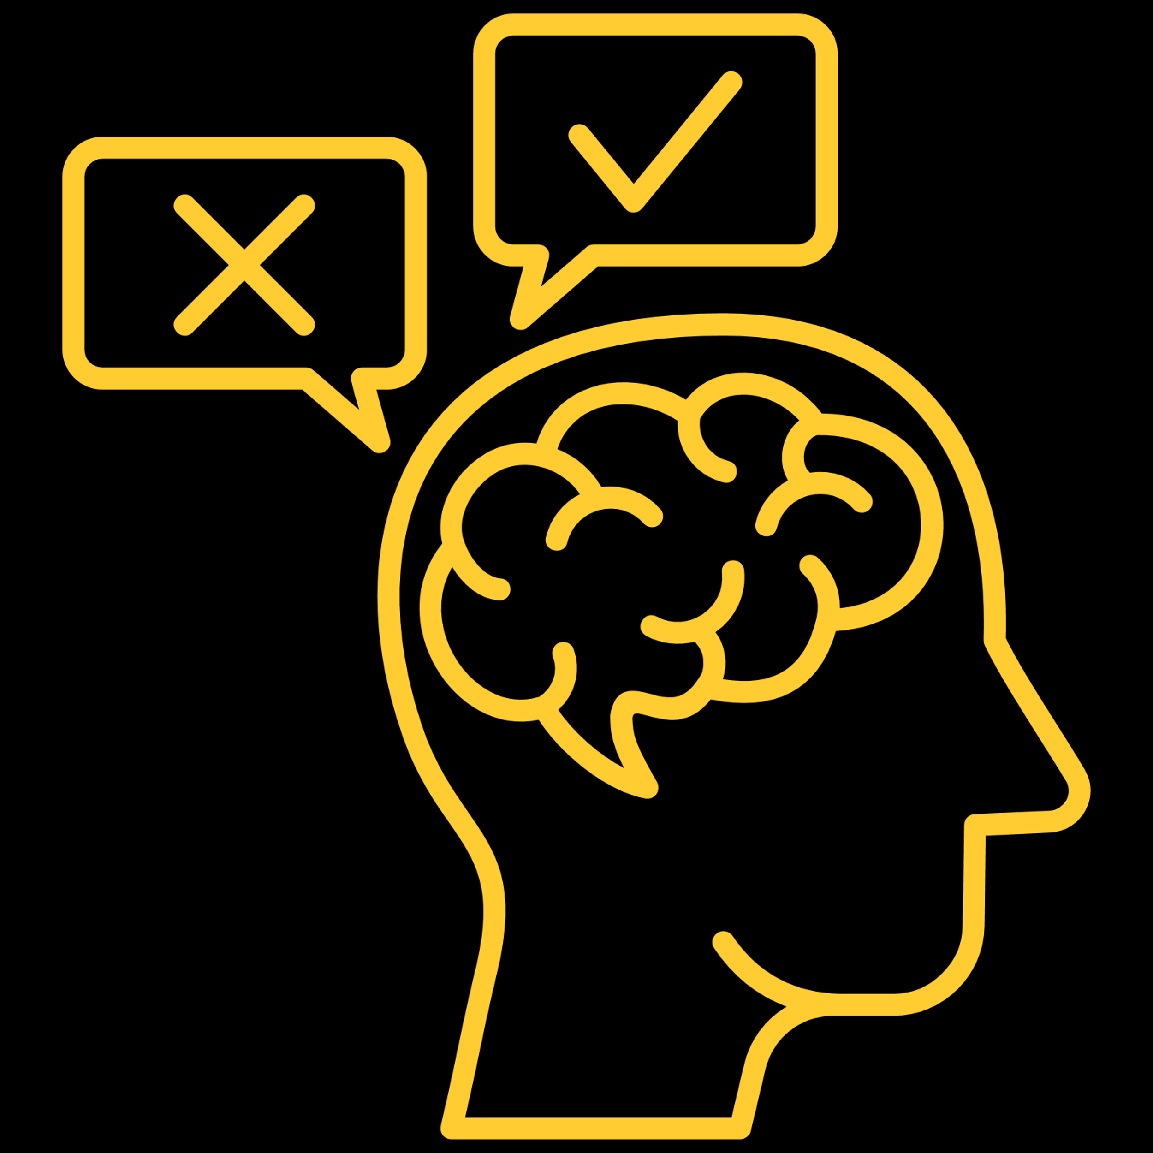

process information more efficiently
bias is universal
Bias (noun)
prejudice in favor of or against one thing, person, or group compared with another, usually in a way considered to be unfair
(statistics) a systematic distortion of a statistical result due to a factor not allowed for in its derivation
(machine learning) a systematic error that occurs in the machine learning model itself due to incorrect assumptions in the machine learning process
Bias (noun)
prejudice in favor of or against one thing, person, or group compared with another, usually in a way considered to be unfair
Bias (noun)
prejudice in favor of or against one thing, person, or group compared with another, usually in a way considered to be unfair
(statistics) a systematic distortion of a statistical result due to a factor not allowed for in its derivation
Notes:
Bias is most commonly defined as “prejudice in favor of or against one thing, person, or group compared with another, usually in a way considered to be unfair.”
However, bias has different meanings depending on the context, and is not always bad.
<<*>>Bias is universal among humans. <<*>>Biases enable people to process information more efficiently and can be adaptive in some circumstances.
<<*>>In statistics, bias is “a systematic distortion of a statistical result due to a factor not allowed for in its derivation”
<<*>>In machine learning, bias is “a systematic error that occurs in the machine learning model itself due to incorrect assumptions in the ML process”
In this course, we will specifically consider unwanted bias as it pertains to an AI or analytics decision system.

Slide 18

Human Bias
human bias
Recency
recency
Affinity
affinity
manual
decision-making
Anchoring
anchoring
Notes:
Manual decision-making is subject to human bias.
Recency: This is where it's a type of cognitive bias where the most recent information that we obtained is the most memorable.
Affinity: Also called similarity bias -- another type of bias where we have a disproportionate preference for individuals or things that we relate to in some way.
Anchoring: Bias where an initial piece of information, sometimes called a reference point or an anchor, influences our perception

Slide 19

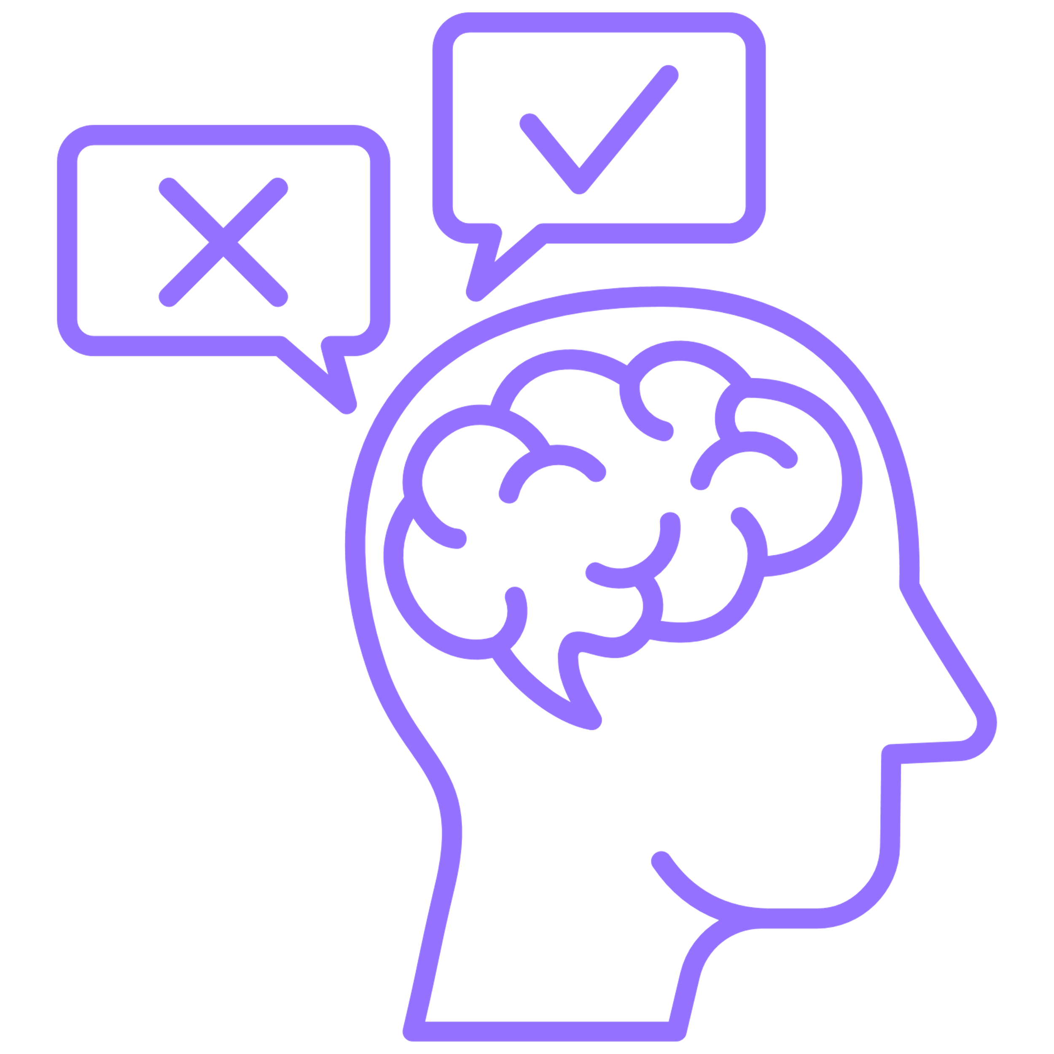
human bias
carefully measured variables
explainable algorithms
transparent scoring logic
recency
affinity
anchoring
human oversight
human oversight
human oversight
manual
decision-making
automated
decision-making
Notes:
How to combat human bias: choosing the right variables, models that are explainable, and being transparent with why certain outcomes were chosen.
Automating your data-driven decision-making can also remove some unwanted bias. However, just because a decision is made automatically doesn't mean that it's unbiased, or ethical, or even correct., automation can even magnify and exacerbate unfairness in a system. This isn’t malicious. The AI machine just does what it's programmed to do.
Human oversight is the solution – call this the “Human In the Loop Approach” where everyone from designers to data stewards to data scientists look for and mitigate bias and unfairness in the system.

Slide 20
I can reduce bias against vulnerable groups by excluding information about group membership in my model.
gender
age
ethnic origin
Notes:
A common perception is that omitting information about protected attributes, such as gender, age, or ethnic origin can guarantee that an AI system is not biased and does not lead to discrimination. It's believed that a simple way to reduce bias against vulnerable groups is to exclude information about group membership in the model.
This is not necessarily true!

Slide 21
It is not sufficient to identify and remove sensitive variables from models.
proxies
discrimination
Mitigating bias is an
active and intentional
part of data analysis.
Notes:
Information can potentially indicate protected characteristics by proxy, which can often be found in data sets, and can lead to discrimination. This is because the data often reflect historical bias in other variables that might seem on the surface to be innocuous, so it’s not sufficient to remove sensitive variables from models.
Mitigating bias is an active and intentional part of data analysis.

Slide 22
Lack of awareness about bias is worse.
Mitigating bias is an
active and intentional
part of data analysis.
It’s important to understand the types of bias that lead to discrimination
Notes:
This point also emphasizes the importance of understanding the types of bias that lead to discrimination. To ensure that the impact of AI systems does not lead to discrimination, AI practitioners might need to include sensitive variables.

Slide 23
The Data Supply Chain, or the Data Chain of Custody
Obtain Data
Manage, Prepare, and Model
Deploy and Consume
Acquire
Store
Pre-process
Model Build
Model Deploy
Share/Sell
Dispose
Notes:
Bringing back up the data chain of custody again, because this is the process with which we ingest we store, we use, and we dispose of data. We just talked about biases. So data comes in an organization in a variety of different ways. But at any point within this data supply chain biases can start to creep in. There's lots of biases that might even be already built into the data before it even reaches this process.

Slide 24
Bias Across The Data Supply Chain
Obtain Data
Manage, Prepare, and Model
Deploy and Consume
Availability Bias
Confirmation Bias
Recall Bias
Selection Bias
Acquire
Store
Pre-process
Model Build
Model Deploy
Share/Sell
Dispose
Notes:
These are the biases that typically appear in the “obtain data” stage.

Slide 25
Unwanted Bias in Obtaining Data
Availability Bias
Making decisions based on readily available data or
recent information alone
Confirmation Bias
When a data scientist interprets or looks for information that is consistent with their own beliefs
Systematic error due to accuracy differences or memory recall completeness of past events or experiences
Recall Bias
Selection Bias
When individuals or groups in a study differ systematically from the population of interest, leading to a systematic error in an association or outcome
Notes:
Availability bias: Making decisions about what is available or recent.
Confirmation bias: Finding information that aligns with what we already believe to be true – cherry picking!! It impacts our ability to ask specific questions, to include certain variables, to interpret findings correctly right and even to deploy particular decisions.
Selection bias: Those in the study don’t represent the population of interest.
Recall bias: Humans naturally remember events as it relates to them, so there will be differences in recollection of events from person to person

Slide 26
Bias Across The Data Supply Chain
Obtain Data
Manage, Prepare, and Model
Deploy and Consume
Aggregation Bias
Attrition Bias
Cause/Effect Bias
Confounding Bias
Exclusion Bias
Hindsight Bias
Historical Bias
Performance Bias
Prediction Bias
Proxy Bias
Survivorship Bias
Time-Interval Bias
Acquire
Store
Pre-process
Model Build
Model Deploy
Share/Sell
Dispose
Notes:
Managing, preparing, and modeling are the core activities of most data scientists. These activities are what give us the “I” part of “AI.” This is also the stage of the data supply chain when many different biases can impact our models.

Slide 27
Unwanted Biases in Manage, Prepare, and Model
Aggregation Bias
Occurs when a one-size-fits all model is used for groups that have different risk distributions
Attrition Bias
Bias introduced by systematic differences between people who leave the study and those who continue voluntarily
Cause/Effect Bias
The most common type of bias seen in data analytics,
when correlation is mistaken for causation
Confounding Bias
Occurs because of having confounders (variables correlated to both the response variable and the predictor variables) in the model
Notes:
Cause/Effect: Correlation does not imply causation!
Attrition: Type of selection bias due to systematic differences between study groups in the number and the way participants are lost from a study.
Confounding: occurs when a real relationship between two things is masked by a third factor (ex: ice cream sales and shark attacks)
Aggregation: Incorrect assumption that the trends seen in aggregated data also apply to individual data points

Slide 28
Unwanted Biases in Manage, Prepare, and Model
Exclusion Bias
Occurs in the data cleaning step when the Data Scientist might remove features considered to be irrelevant
Hindsight Bias
The accidental presence of information in the training
data that will not be available in production
Historical Bias
Occurs when bias, human or otherwise, present in prior decisions is reflected in the training data
Performance Bias
When a model performs poorly on specific groups in the data set compared to others, despite potentially having good performance overall
Notes:
Historical: When previous biases have an effect on current decisions
Performance: Specific to a subgroup of the population that has results less accurate than other groups in the model
Exclusion: Variables that are assumed to be unneeded are removed
Hindsight: Data that exists in our model creation and testing that won’t be available in production

Slide 29
Unwanted Biases in Manage, Prepare, and Model
Prediction Bias
Occurs when a model predicts an event for one group
more than another on average
Proxy Bias
Occurs in cases where an input or target variable is estimated using a proxy variable that is systematically different from the variable of interest
Survivorship Bias
The logical error of concentrating on the people or things that made it past some selection process and overlooking those that did not
Time-Interval Bias
When a specific time frame is chosen to support hypotheses, resulting in incorrect conclusions because of missing data from other time periods.
Notes:
Proxy: Using a different variable as an input or target
Survivorship: Logical error of concentrating on the people or things that made it past some selection process and overlooking those that did not. Similar to attrition bias
Prediction Bias: When a model predicts an event for one group more than another on average.
Time-Interval Bias: When a specific time frame is chosen to support hypotheses, which results in incorrect conclusions because of missing data from other time periods.

Slide 30
Bias Across The Data Supply Chain
Obtain Data
Manage, Prepare, and Model
Deploy and Consume
Automation Bias
Deployment Bias
Drift Bias
Reporting Bias
Acquire
Store
Pre-process
Model Build
Model Deploy
Share/Sell
Dispose
Notes:
Fewer biases here, but this stage is not immune!

Slide 31
Unwanted Biases in Deploy and Consume
Automation Bias
The propensity for humans to favor suggestions from automated decision-making systems even when it is incorrect, and to ignore contradictory information made without automation even if it is correct
Deployment Bias
Occurs when there is a mismatch between the problem a model is intended to solve and the way in which it is actually used
Model Drift
Bias that can occur over time post implementation due to data drift or concept drift
Reporting Bias
Bias that arises from the selective disclosure or
withholding of information by parties involved in the design, conduct, analysis, or dissemination of a study
or research findings
Notes:
Automation: Favoring suggestions made by automated systems (even when it's incorrect) and ignoring any contradictory information made without automation (even if it is correct)
Deployment: Using the model in a way that is not what it was made for
Model Drift: Occurs over time post implementation due to data drift or concept drift.
Reporting Bias: Arises from the selective disclosure or withholding of information by parties involved in the design, conduct, analysis, or dissemination of a study or research findings.

Slide 32
Principles of Responsible Innovation

Slide 33

Inclusivity
Human-Centricity
Responsible Innovation
Accountability
Transparency
Privacy & Security
Robustness

Slide 34
Human-Centricity
Promote human well-being, human agency, and equity.
Notes:
Emphasize the importance of understanding and addressing the needs and the values of the people who are going to be impacted by the solution
Data science is not just about analyzing and interpreting data. But it's about using that data to solve problems and to make decisions that actually have a positive impact on people's lives.
This understanding drives that principle of human centricity where data driven systems should be designed to promote and preserve human dignity, human agency (being able to act on our behalf) and overall wellbeing, all with an eye towards equity for all humans.

Slide 35
Inclusivity
Ensure accessibility and include diverse perspectives and experiences.
Notes:
Data driven systems carry the potential to amplify societal biases and biases tend to lead to discriminatory practices where not every subgroup of the population is treated the same or treated fairly.
Our data might reflect power imbalances and can further marginalize vulnerable populations that really should be protected, so intentional measures have to be taken so that our solutions serve all members of our community in the same way.
These systems have to be accessible, and they have to reflect diverse perspectives and experiences, so that we are inclusive of all members of our society.

Slide 36
Accountability
Proactively identify and mitigate adverse impacts.
Notes:
We’ve seen that bias can sneak into all aspects of the data chain of custody..
This is a shared responsibility of all members that play a part in the analytics lifecycle - from data collection to the data driven decision making that happens at the end. Anyone on the spectrum of responsibility needs to be aware of the role that they play and to mitigate and remediate any adverse impacts.
So accountability means that each member that's involved in anywhere in this life cycle is accountable for and responsible and proactively does work to mitigate any adverse impacts.
And this this ensures overall accountability for the systems that are being built.

Slide 37
Privacy & Security
Respect the privacy of data subjects and the security of data products.
Notes:
In the context of AI ethics, Privacy is best understood as the extent to which people whose data we collect and deploy AI on have knowledge and control over what data is being use
We want to make sure that our products are secure. This is how we foster trust with our users

Slide 38
Robustness
Operate reliably and safely while enabling mechanisms that assess and manage potential risks throughout a system’s life cycle.
Notes:
Data driven systems have to operate as intended or designed and applied to the right solutions. They have to produce consistent and accurate results, and they have to have clear guidelines for safe operation.
Being robust means it can operate reliably and safely.
We have to make sure our systems are carefully tested that we're giving a wide range of possible inputs so that we can mimic some real world scenarios and we can foresee any harms that might come from that system being used and from decisions that are being made at the end.

Slide 39
Transparency
Explain and instruct on usage openly, including at minimum potential risks and how decisions are made.
Notes:
We openly communicate the inner workings, or maybe the limitations, the restrictions or any adverse impacts that our system or the decisions that we make from that system might stem from. In order to foster trust, people have to know when an AI system is being used and what to expect from it.
It’s important that we explain and we instruct on the usage of our systems. It means that we communicate any risks that might exist and explain how decisions are made and when they might impact a subject.

Slide 40
Striving for Excellence across the AI and Analytics Life Cycle
We want AI to improve the world.
AI practitioners seek to do no harm and to address injustice.
Ethical and legal are not the same.
We aim to protect vulnerable groups.
Responsible innovation is intentional.
Notes:
We think that responsible innovation, in artificial intelligence in particular, has the potential to improve the world for all of humanity.
But responsible innovation is a practice, and it is intentional. It requires intentional effort on the part of all of those that are involved in designing solutions, scoring models, automating processes.
It requires looking beyond just what is legal. It also requires looking at what is ethical.
Biases have the most negative impact on vulnerable groups. Think back to all the different biases that showcase this.
AI practitioners should seek to do no harm and to address address injustices. Software has to be designed in such a way that enables users to be responsible innovators.
But ultimately that software is neither ethical nor unethical. It's neither lawful nor unlawful.
Software just does what it's programmed to do. And we have to understand that we are the stewards, we the users of the software, the developers of the software, have to consider what our responsibility is to humans, to the planet, to the economy and society at large.

Slide 41


Responsible Innovation and Trustworthy AI
https://learn.sas.com/course/view.php?id=6443

Slide 42
Responsible Innovation and Trustworthy AI
Modules:
Overview of Trustworthy AI and the Analytics Lifecycle
AI Risk and Unintentional Bias
Principles of Responsible Innovation Overview
Focus on Human Centricity
Focus on Inclusivity
Focus on Accountability
Focus on Privacy and Security
Focus on Robustness
Focus on Transparency
SAS Technology for Responsible Data Management
SAS Technology for Responsible Model Development
SAS Technology for Responsible Model Deployment
https://learn.sas.com/course/view.php?id=6443

Slide 43
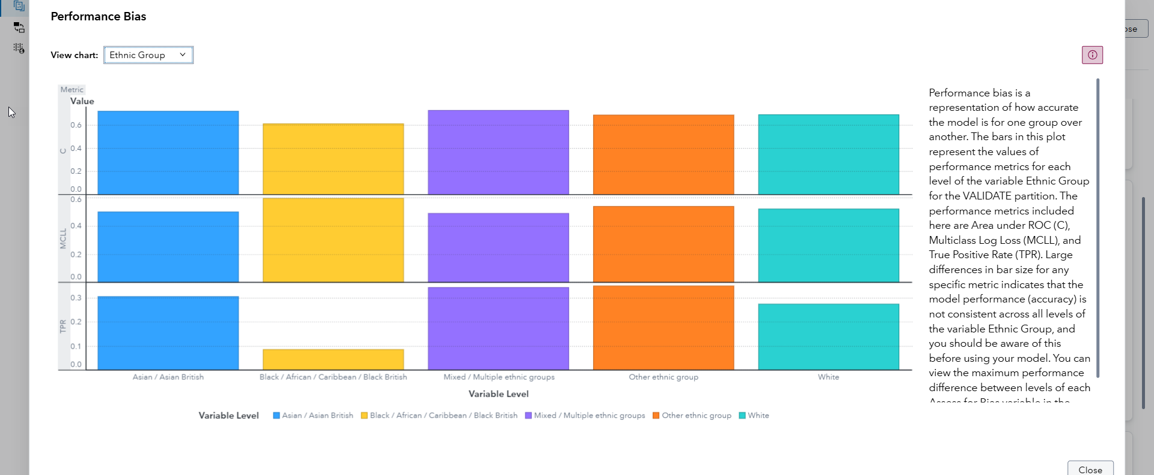
Identifying and Addressing Bias in SAS

Slide 44
SAS Viya for Learners

Slide 45

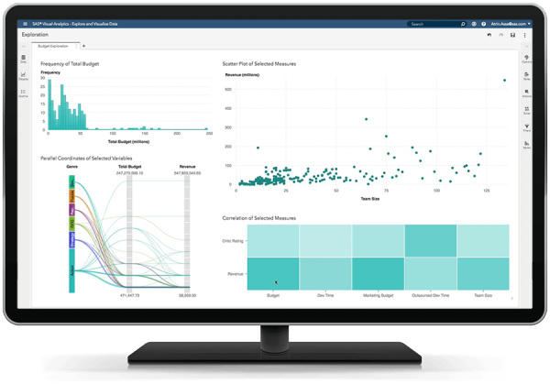
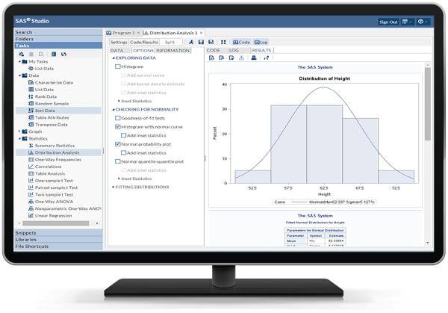
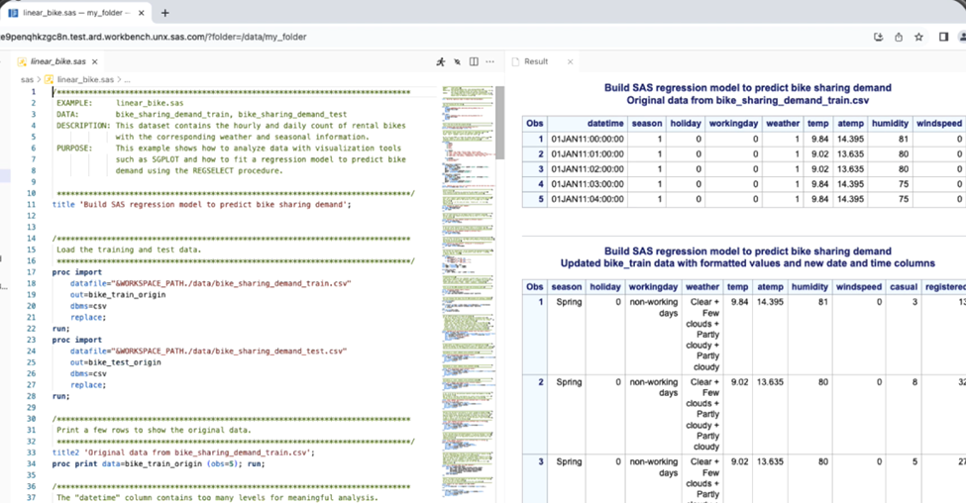
Software for Teaching and Learning
Free Academic Software
VFL
ODA
WFL
SAS® Viya® for Learners
SAS® OnDemand for Academics
SAS® Viya® Workbench for Learners
www.sas.com/viyaforlearners
www.sas.com/ondemand
www.sas.com/wfl
Notes:
www.sas.com/viyaforlearners
www.sas.com/ondemand
www.sas.com/wfl

Slide 46

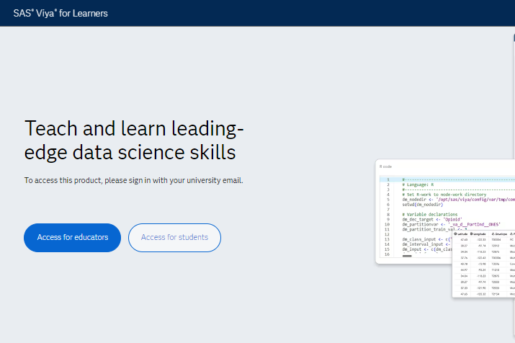
SAS Viya for Learners
Free Software
Free to students and faculty
Cloud environment
Use .edu email when registering
Works best with Chrome browser
Programming, visualization, modeling, and more!
www.sas.com/viyaforlearners

Slide 47
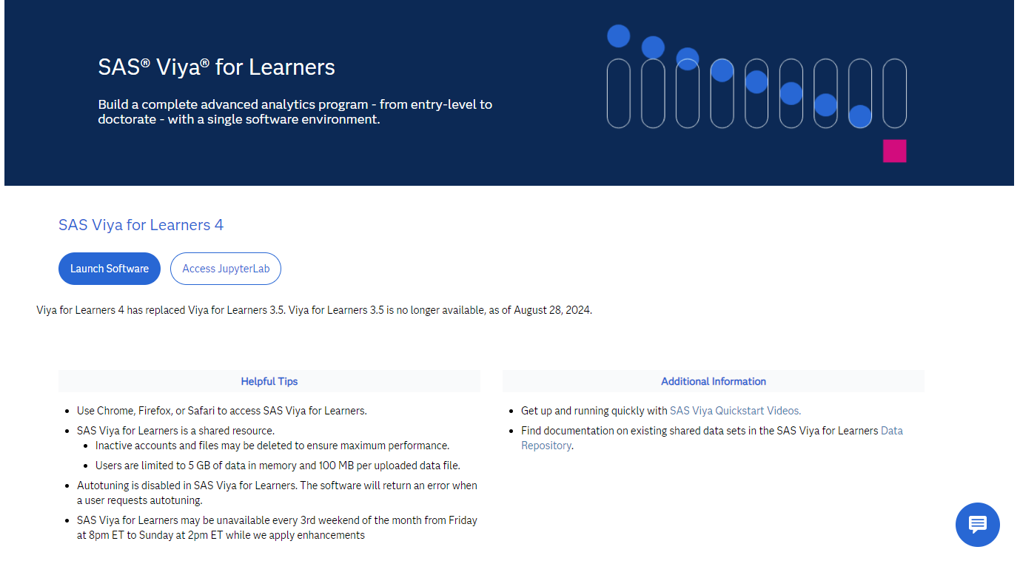
SAS Viya for Learners Launch Page
https://learn.sas.com/vfl

Slide 48

SAS Viya for Learners
Getting Started
https://www.youtube.com/watch?v=NRZPUs3tBM4
Notes:
https://www.youtube.com/watch?v=NRZPUs3tBM4&t=8s

Slide 49
Ethical Data Analysis
Your turn!

Slide 50

Welcome to iLink University!
As a new Predictive Modeler in our Admissions Department, your role will involve shaping the fall 2025 M.S. in Analytics Program class. On your first day, you'll explore Visual Data Mining and Machine Learning tools in SAS Model Studio.
In Part 1, you’ll use historical data to identify successful applicants based on the 'Admissions' variable—a 0/1 indicator showing whether a student was admitted.
In Part 2, you'll discover the Fairness and Bias assessment tools, which allow us to evaluate whether a model should be used and ensure the admissions process is as fair as possible.

Slide 51
Portals

Slide 52


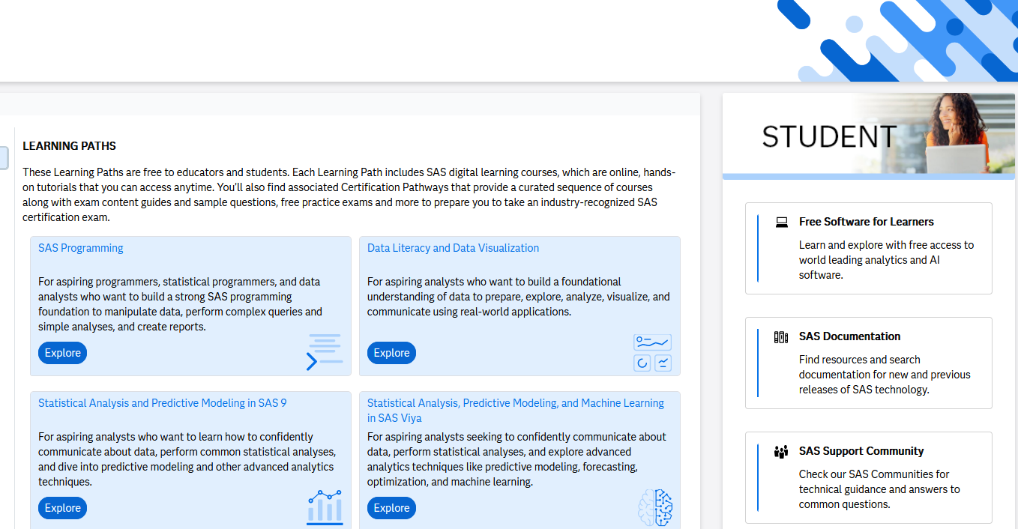
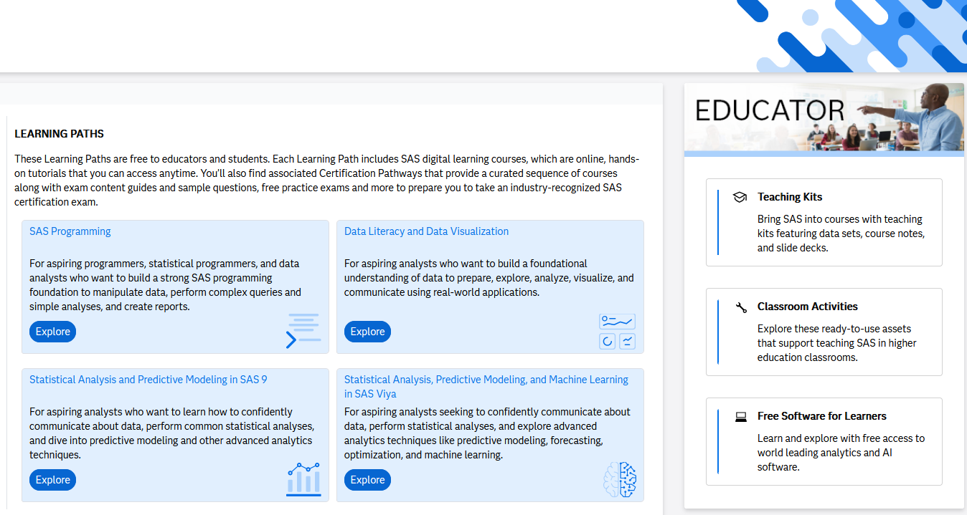
SAS Skill Builder for Students
Free Learning Portals for Academics
SAS Educator Portal
sas.com/skillbuilder
sas.com/educatorportal

Slide 53

Educator Portal
All-in-One Resource Center
Free e-learning and software
Certification paths and preparation materials
Teaching materials
Educator focused workshops & training
Discounts & promotions
www.sas.com/teach

Slide 54
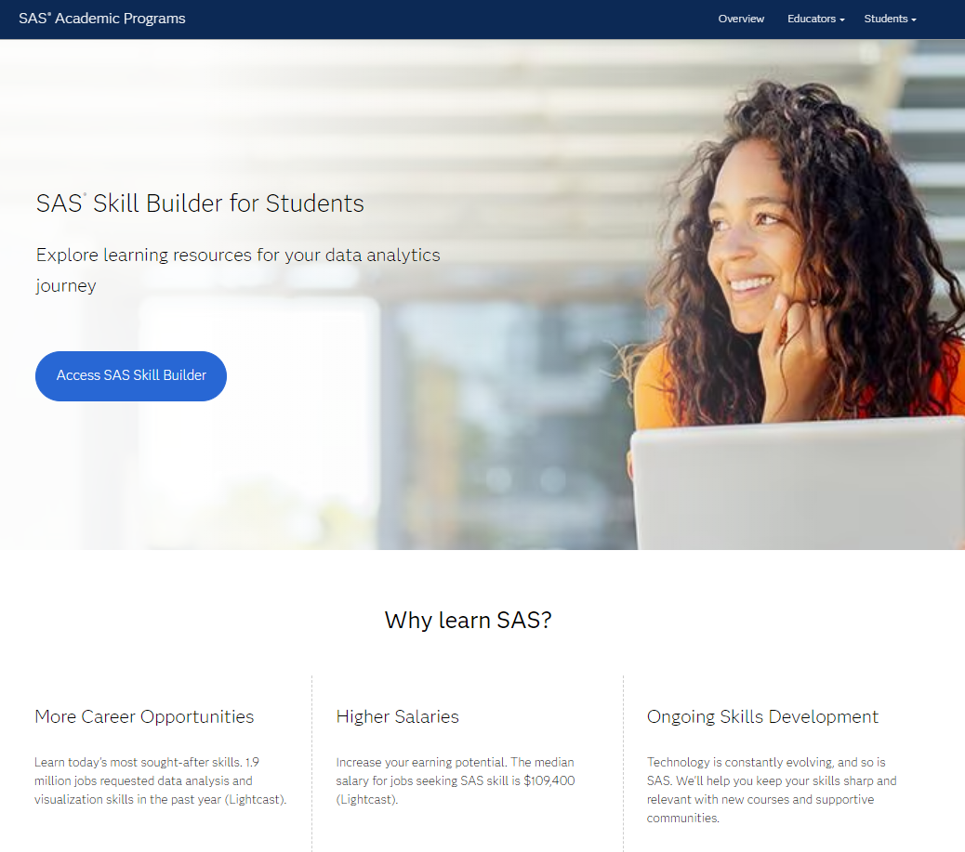
SAS Skill Builder for Students
Your future starts here
Learn on your time
Free e-learning courses
Certification prep materials and exam discounts
Free software
Three cloud-based options
Stay motivated!
Early career resources
Discover why data analytics is a rewarding career path
Learn about what it means to be a data analytics professional
Connect with employers
Cross-industry access
Analytical skills for any discipline
www.sas.com/skillbuilder

Slide 55
Portals
Let’s have a look!

Slide 56
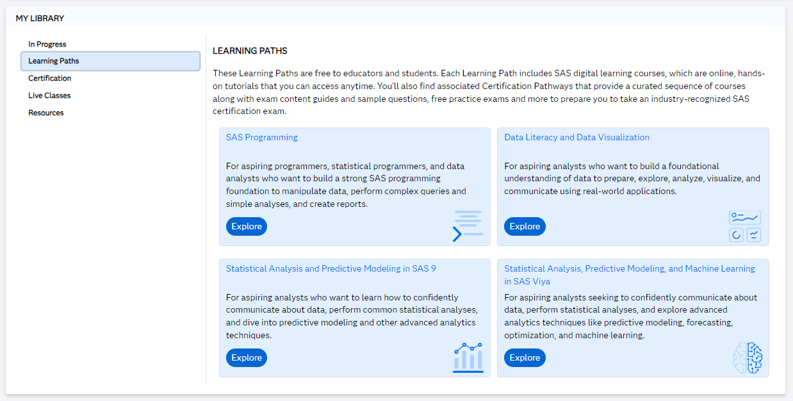
Free e-Learning Courses
https://learn.sas.com/my/

Slide 57
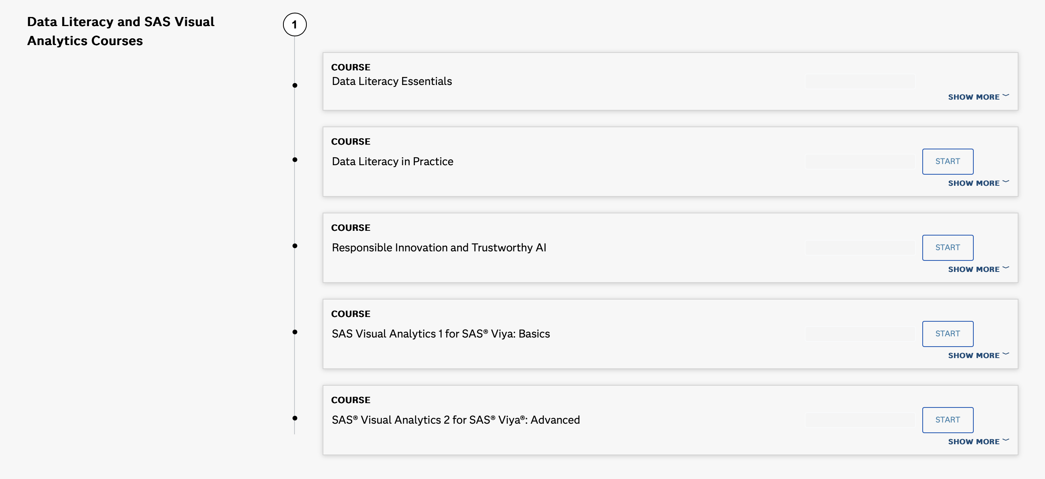
Learn More!

Slide 58
SAS Educate 2025
July 21–24, 2025 | Virtual
Ready to level up your approach to teaching AI & Analytics? Join us for SAS Educate 2025, a dynamic virtual learning week designed exclusively for faculty. From July 21–24, connect with fellow educators, industry leaders, and SAS experts as we explore the innovations shaping the future of education and the workforce.
What’s in store? Get inspired, gain practical insights, and bring fresh ideas to your classroom with sessions covering:
A week-long Cortex Simulation Game that will challenge your strategic thinking skills
Best practices and success stories in curriculum development
Emerging topics in generative AI and ethical innovation
Talent connections and industry partnerships to help bridge the gap between education and careers
The value of SAS certification for students and professionals
…And much more!

Slide 59
SAS Academic Specializations
Standard Requirements
Reading materials
At least one required or recommended reading material using SAS per course.
Hands-on learning
Lab, course project, practicum, thesis, conference presentation, etc.
Credit hours
At least 6, 9, or 12 credit hours of required courses using SAS at least 50% of the time.
Graded assignment
At least one assignment with applied SAS use per course.
www.sas.com/academic-specialization

Slide 60
More Resources

Slide 61

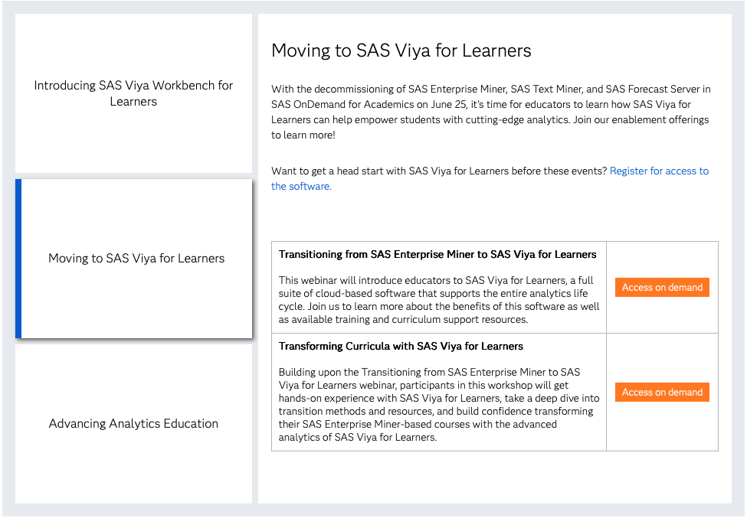

Free Academic Workshops
www.sas.com/academicworkshops

Slide 62

SAS Communities
www.sas.com/communities
Get SAS tips, share your knowledge, and find out about upcoming events.
SAS Communities gives you immediate access to thousands of SAS users across the globe.
From learners to data professionals, the platform provides valuable connections and insights into real world problems and processes.
There is no data problem too obscure!
Global community of users for 24/7 support.
Case studies, documents, blogs, webinars, and more.

Slide 63
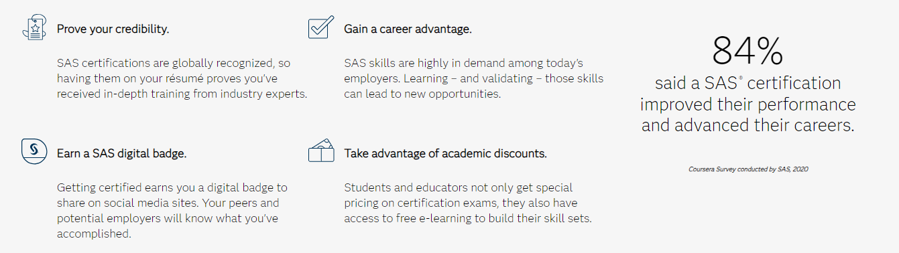
Why Get SAS Certified?
https://www.sas.com/en_us/certification/why-get-certified
.html

Slide 64
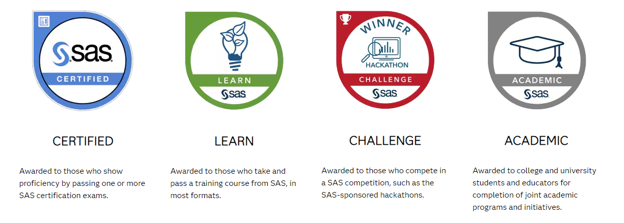
SAS® Digital Badges
https://www.sas.com/en_us/certification/why-get-certified.html

Slide 65
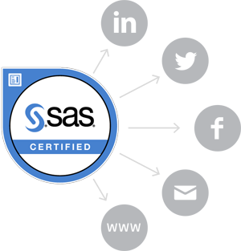
SAS® Digital Badges
Allows employers to verify SAS skill attainment
Creates a distinction between you and students from other programs without the certification
Shows commitment to learning and advanced knowledge
Makes you more competitive in the current job market
Increases resume/CV visibility provided to prospective employers

Slide 66
Helpful Resources
SAS Visual Analytics Gallery
A place to share and chat about visualizations.
Ask the
Expert
View other user webinars that provide insights into using SAS products to make your job easier.
SAS Support Communities
Ask questions, get answers and share insights with SAS users.
SAS Users YouTube Channel
A plethora of videos on hundreds of topics, just for SAS users.

Slide 67
Thank you!

